Slide 1
UI Application Design
RCET

Slide 2
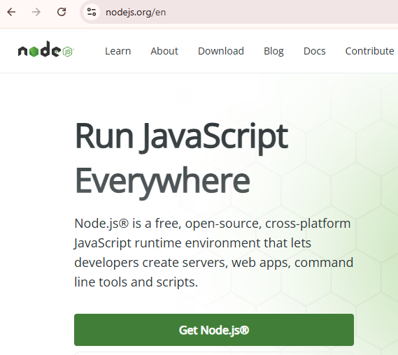
Node.js Installation

Slide 3
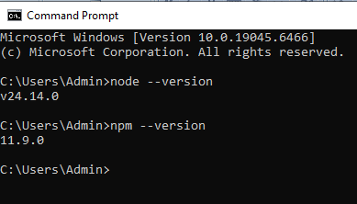
Check Node and Npm versions

Slide 4
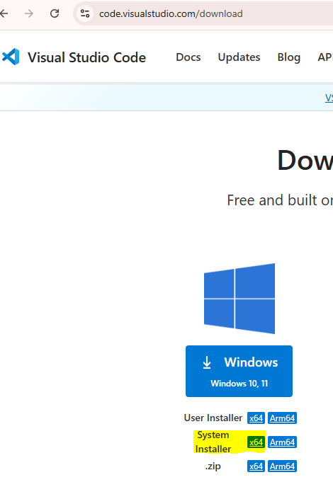
Vs Code Installation

Slide 5
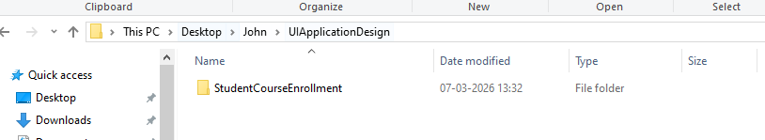
Workspace Folder Creation

Slide 6
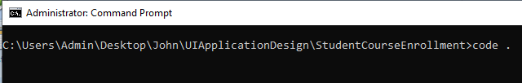
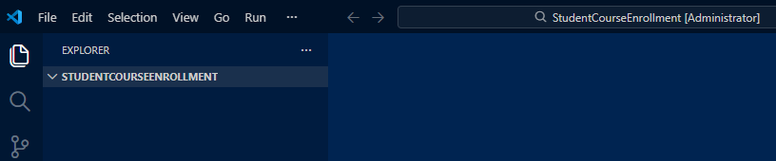
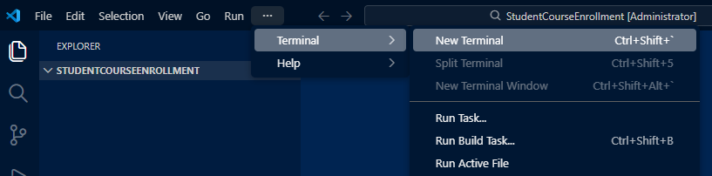
Open Workspace Folder in VS Code from Command Prompt

Slide 7
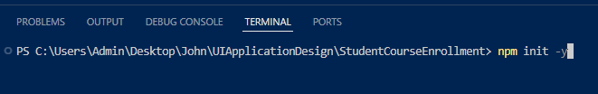
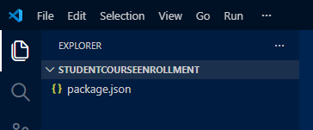
Package.json

Slide 8
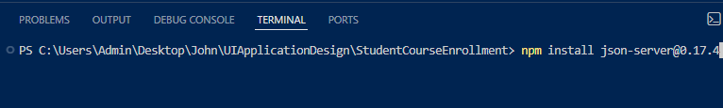
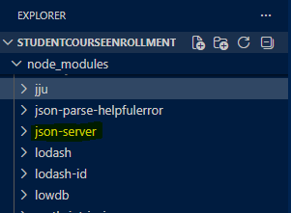
Install Json Server

Slide 9
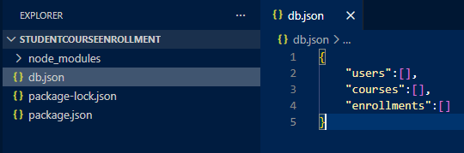
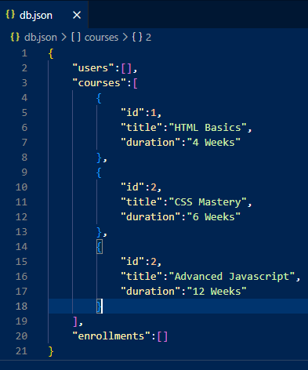
db.json

Slide 10
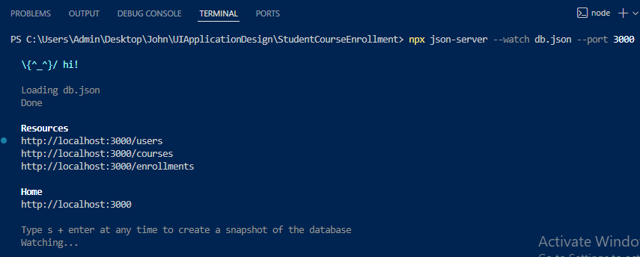
Start JSON Server

Slide 11
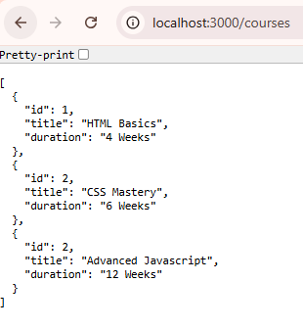
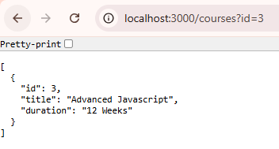
Open http://localhost:3000/courses in browser

Slide 12
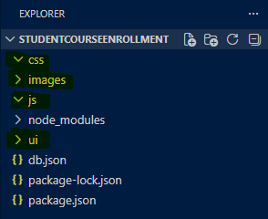
Project Folder Structure

Slide 13
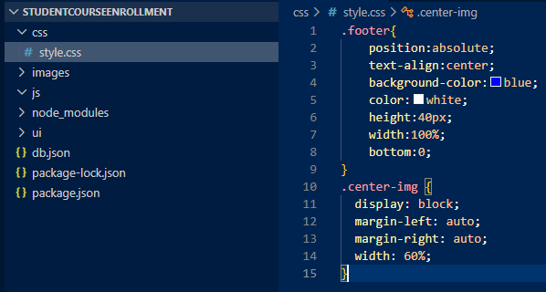
css/style.css

Slide 14
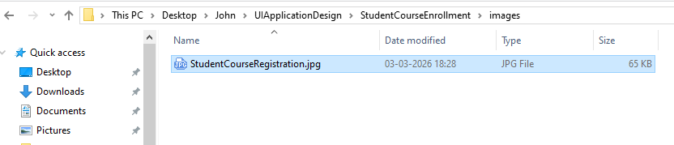
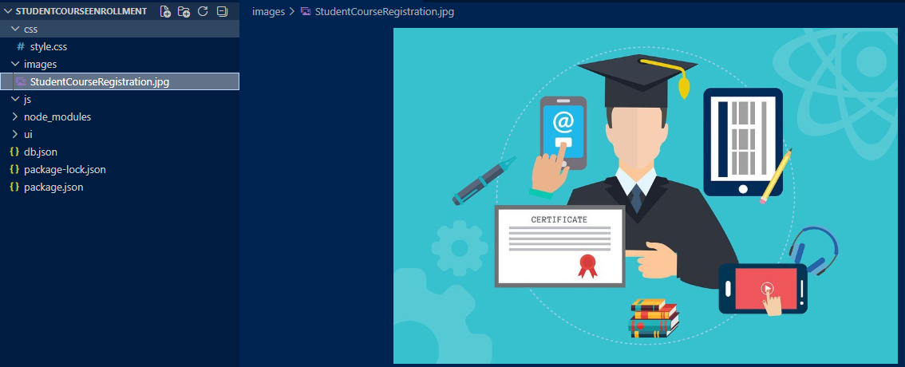
Images/StudentCourseRegistration.jpg

Slide 15


Slide 16
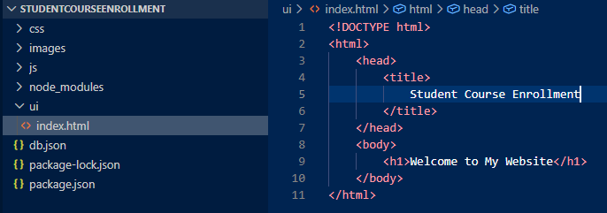
ui/index.html

Slide 17
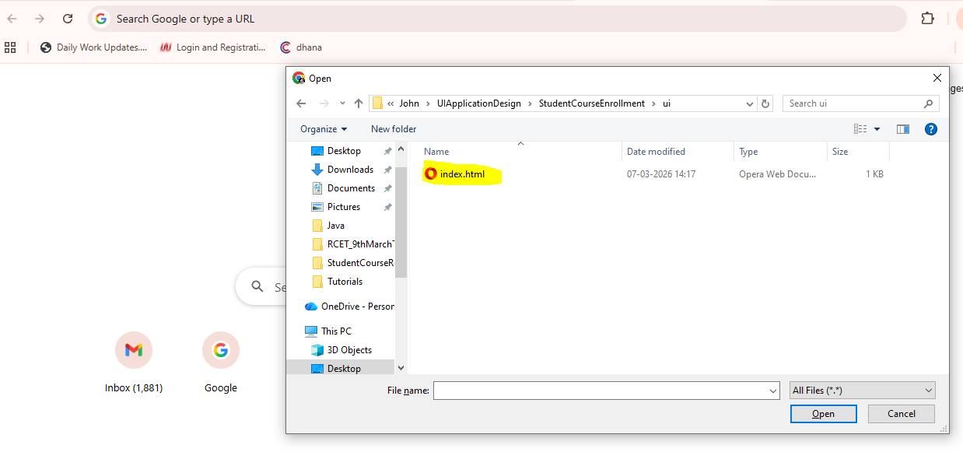
Open Chrome Browser. Ctrl + O. Select index.html

Slide 18
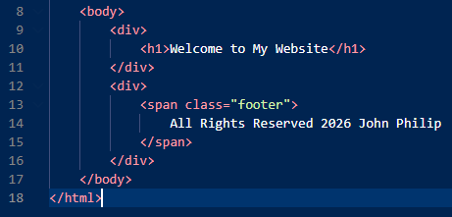
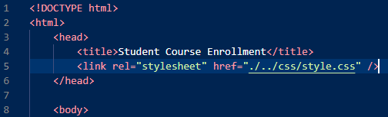
Footer in index.html

Slide 19
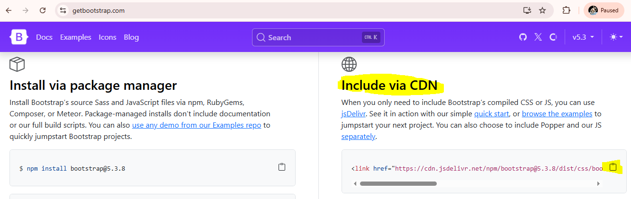

Copy bootstrap CDN and paste in index.html

Slide 20
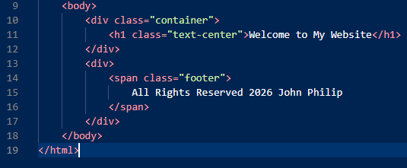
Bootstrap classes – container and text-center

Slide 21
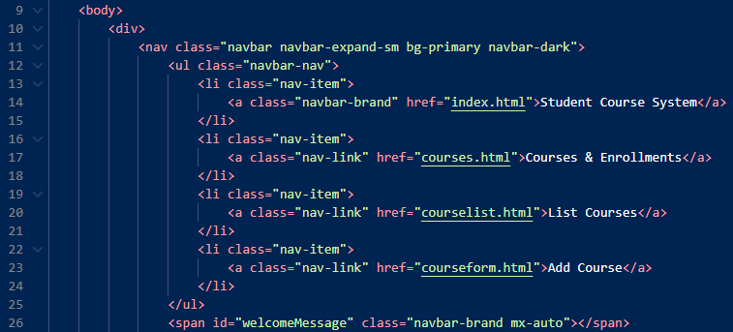
Navigation Bar - 1

Slide 22
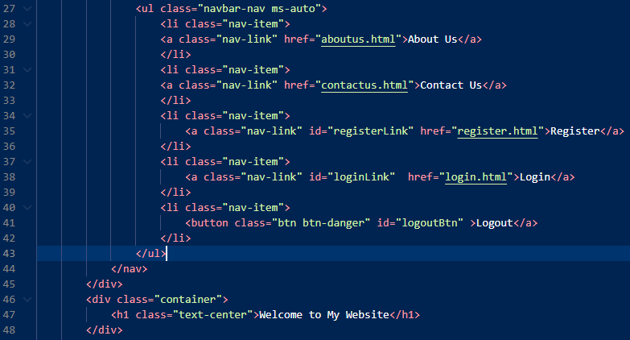
Navigation Bar - 2

Slide 23
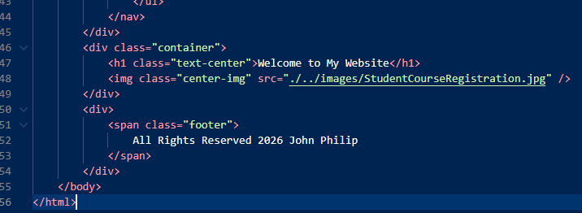
Image in index.html

Slide 24
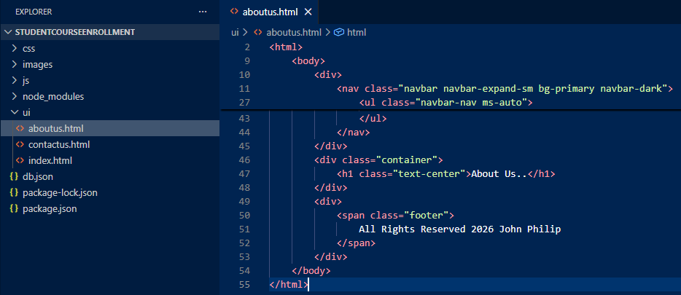
ui/aboutus.html

Slide 25
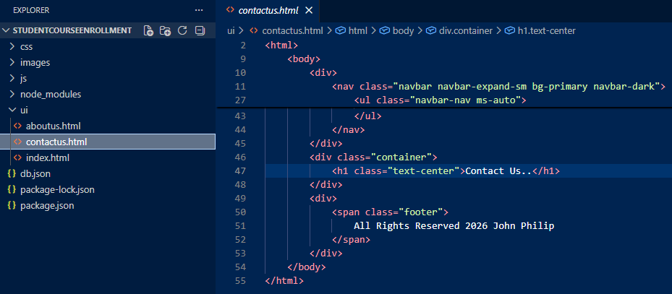
ui/contactus.html

Slide 26
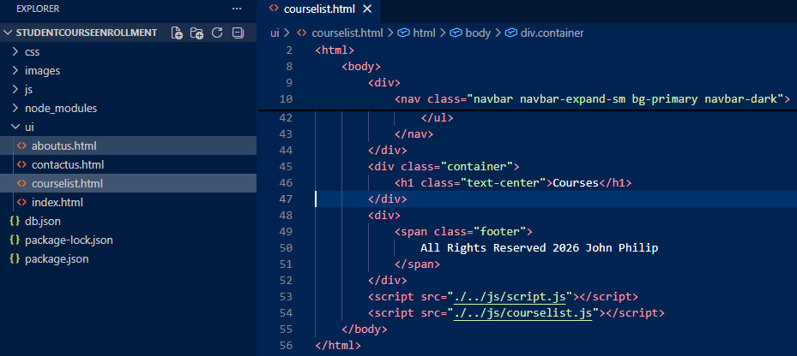
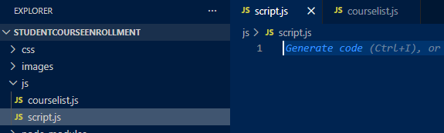
ui/courselist.html

Slide 27
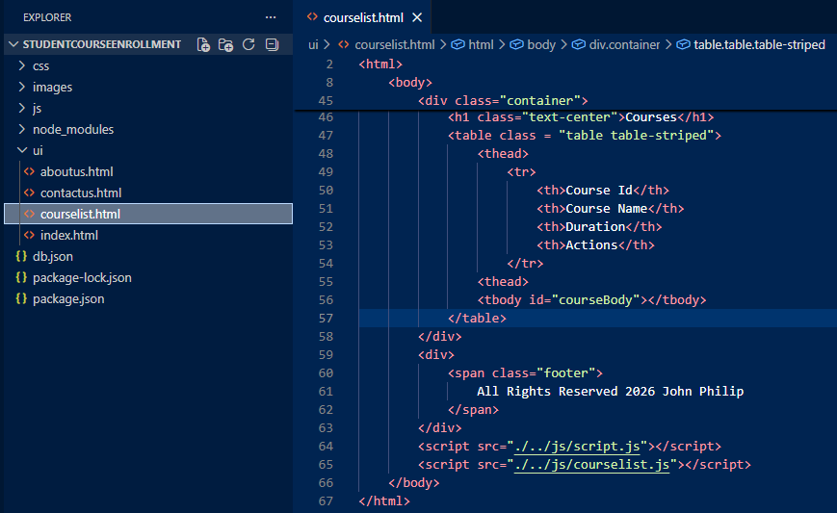
Courses table

Slide 28
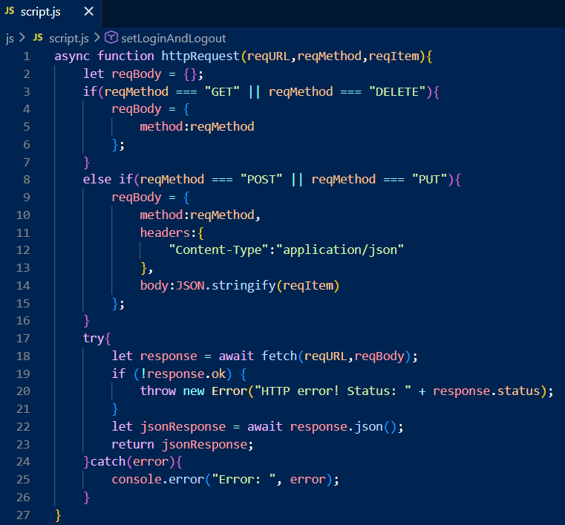
HTTP – GET, POST, PUT and DELETE

Slide 29
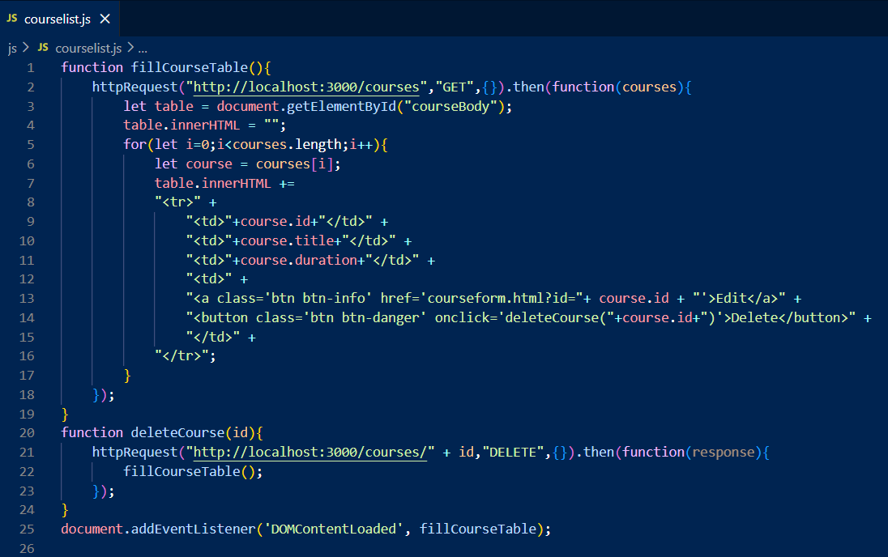
js/courselist.js – Read All Courses (GET) and Delete (DELETE)

Slide 30
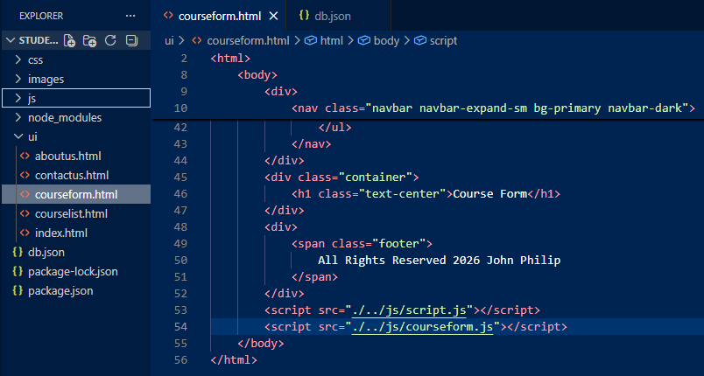
ui/courseform.html

Slide 31
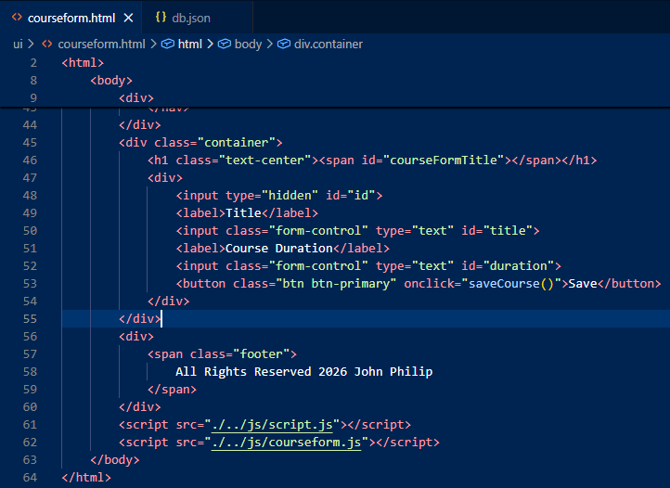
ui/courseform.html (Create)

Slide 32
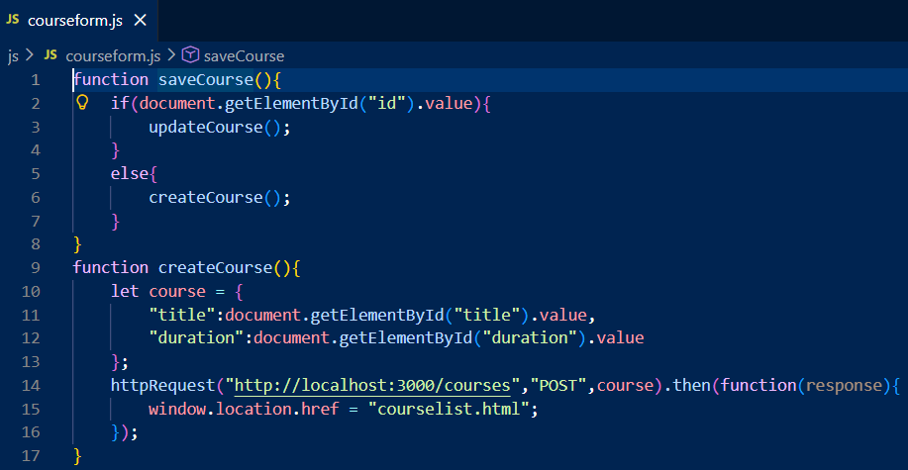
js/courseform.js (POST)

Slide 33
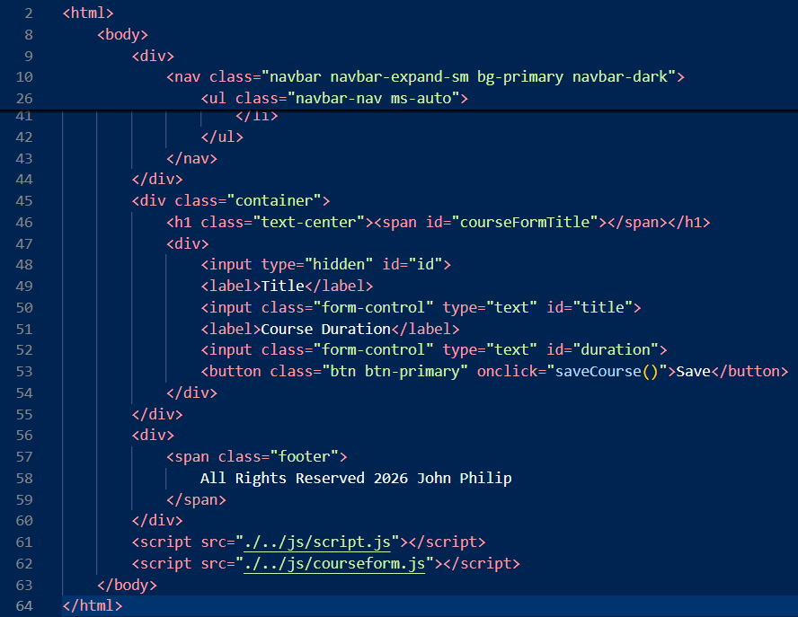
ui/courseform.html (Update)

Slide 34
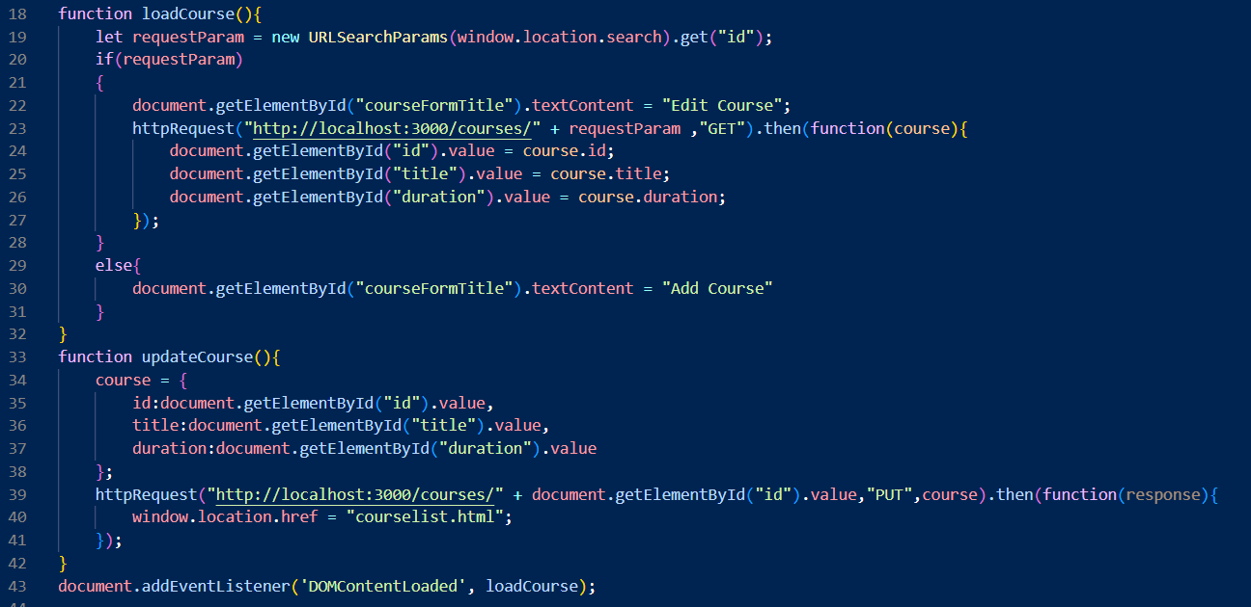
js/courseform.js (load and update course)

Slide 35
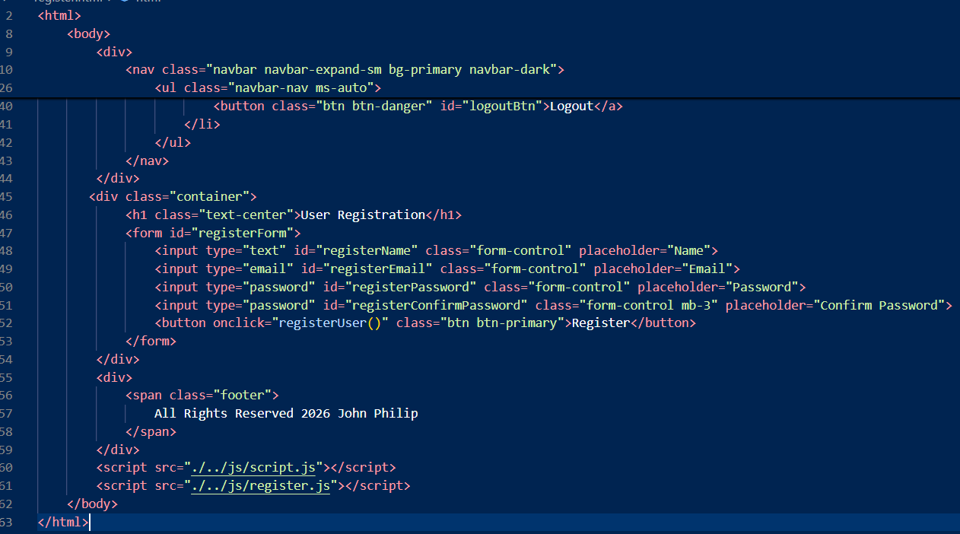
ui/register.html

Slide 36
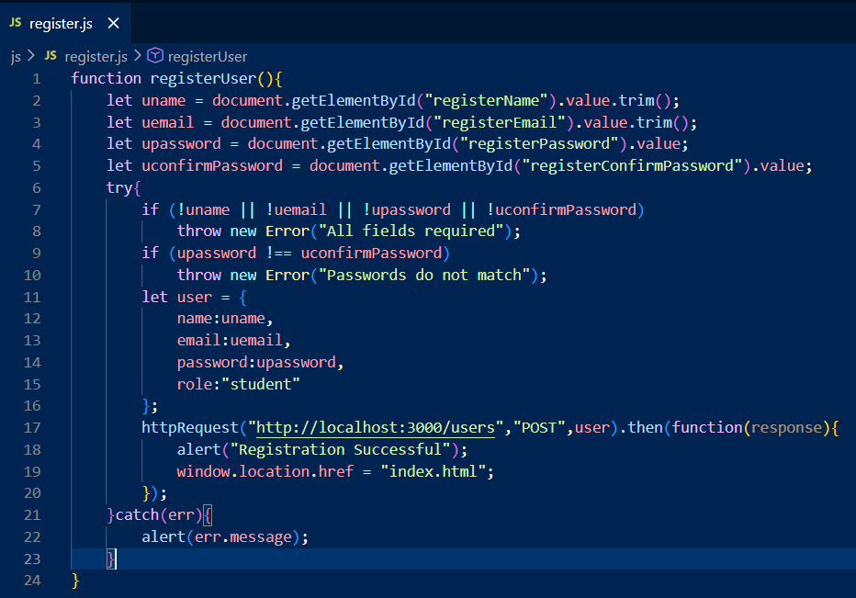
js/register.js

Slide 37
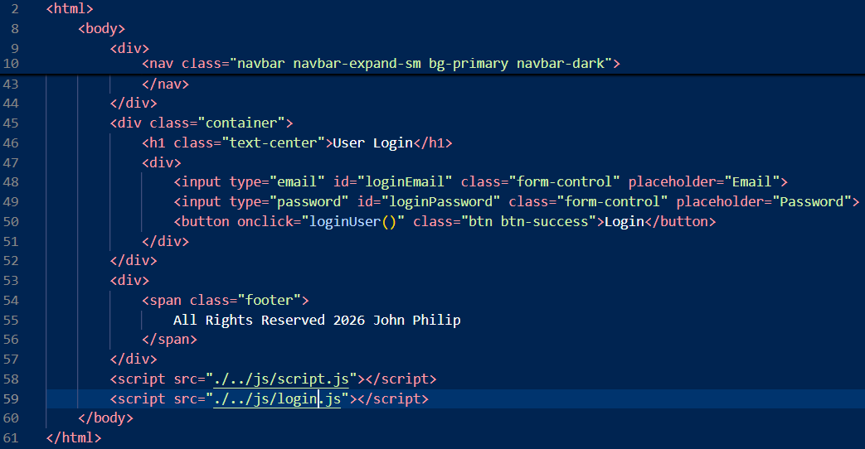
ui/login.html

Slide 38
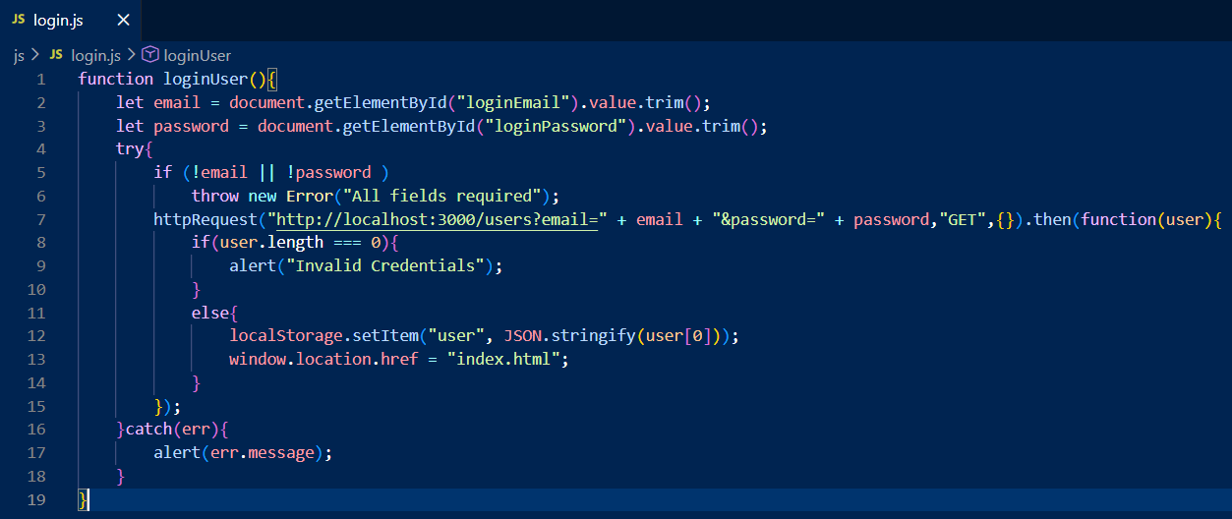
js/login.js

Slide 39
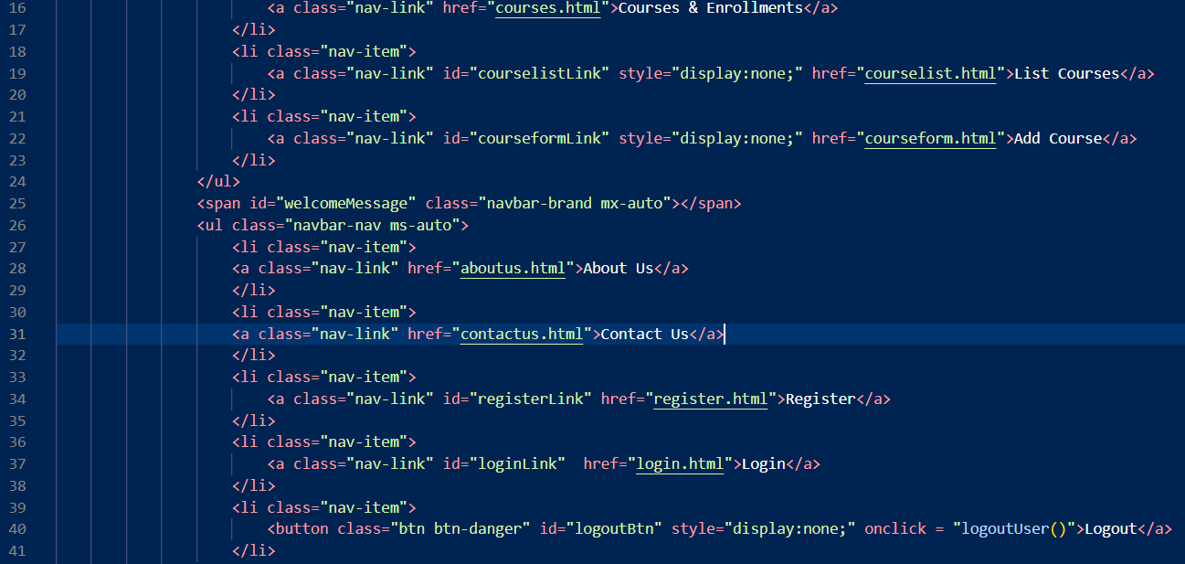
ui/index.html (Logout button)
Apply this change to all html files

Slide 40
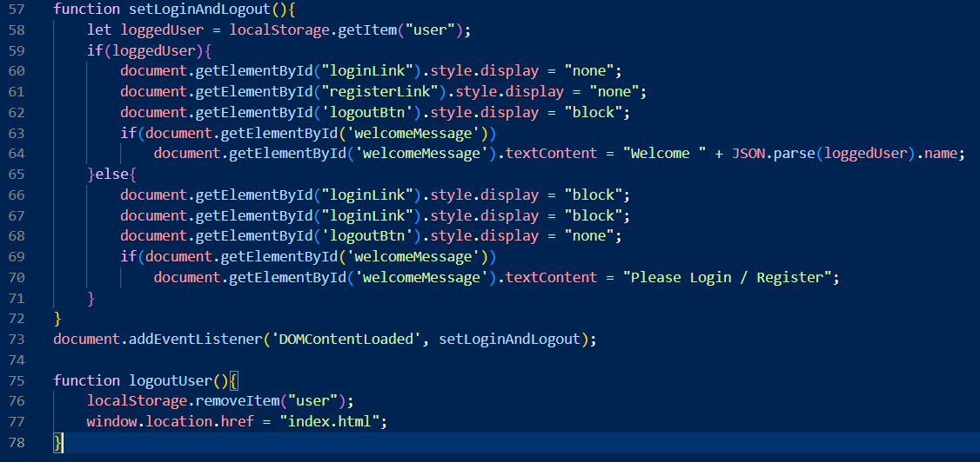
js/script.js (Logout)

Slide 41
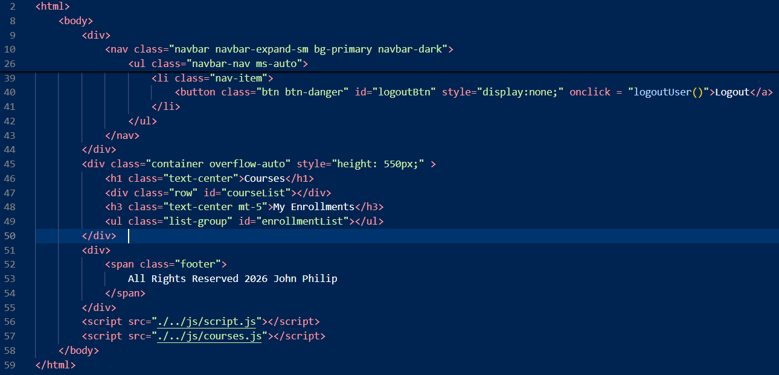
ui/courses.html

Slide 42
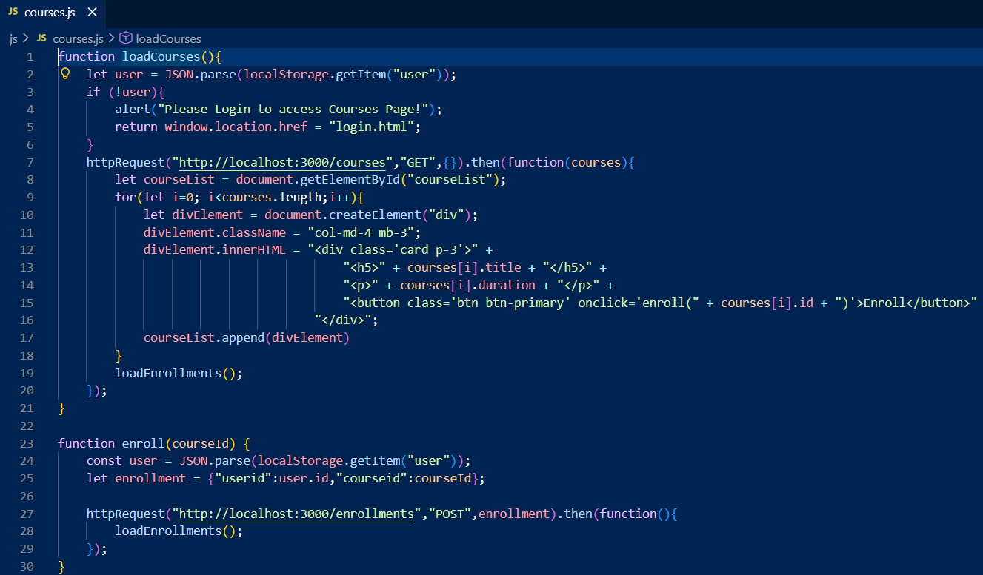
js/courses.js (display courses)

Slide 43
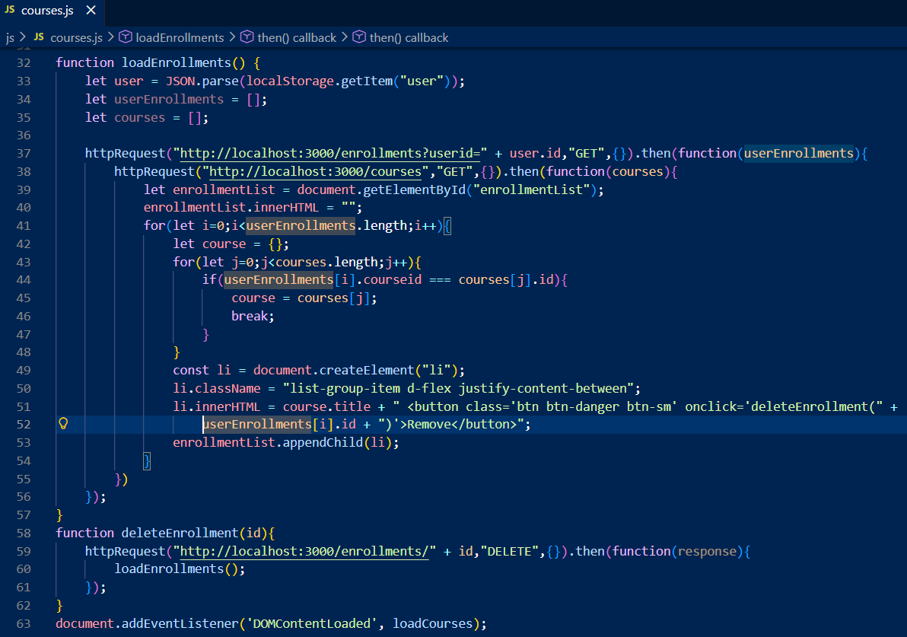
js/courses.js (Add / Delete Enrollment)

Slide 44

js/script.js (For Admin access)

